Slide 1


Challenges in LLM Inference Infrastructure and How Networks Can Help
Yibo Zhu
CTO, StepFun
August 7th, 2026

Slide 2

Outline
Background
DistServe [OSDI’24]: prefill-decode disaggregation
Attention-FFN disaggregation
InfiniHBD [SIGCOMM’25]: scalable high-bandwidth domain
to facilitate disaggregation
Notes:
Today I’ll go over three of our projects at StepFun. The first two are about large language model inference and the last was published in SIGCOMM last year.
Some of you may already know about them. prefill-decode disaggregation is now a very classic technique, and attention-FFN disaggregation is also getting some momentum.
As one of the original authors, I will share behind-the-scene stories and thoughts, so you can still learn some insights.
Before the projects, let me start with background.

Slide 3








The Progress of Large Language Model (LLM)
AGI is near
Five levels of AI by OpenAI
Chatbot
Reasoning
Agent
Innovator
Organization
2022 H2–2024 H1
2024 H2–2025 H1
2025 H2–now
Representative models and applications
GPT-3.5
GPT-4
O1
2.5
Opus 4.8 GPT 5.6
Intelligence
LiveBench LLM No.1 in China
OpenClaw token usage No.1 Globally
StepFun models
Step 1 / Step 2
Step 3
Step 3.5 Flash
Step 3.7 Flash
Notes:
In the last three years, LLM had a big progress. In the beginning, OpenAI laid out five levels, from L1 to L5.
We started from L1 chatbot (like chatgpt), and we had reasoning (o1 and deepseek r1), now we have entered L3 agent era.
StepFun is a foundation model startup. We have trained several generations of models…

Slide 4
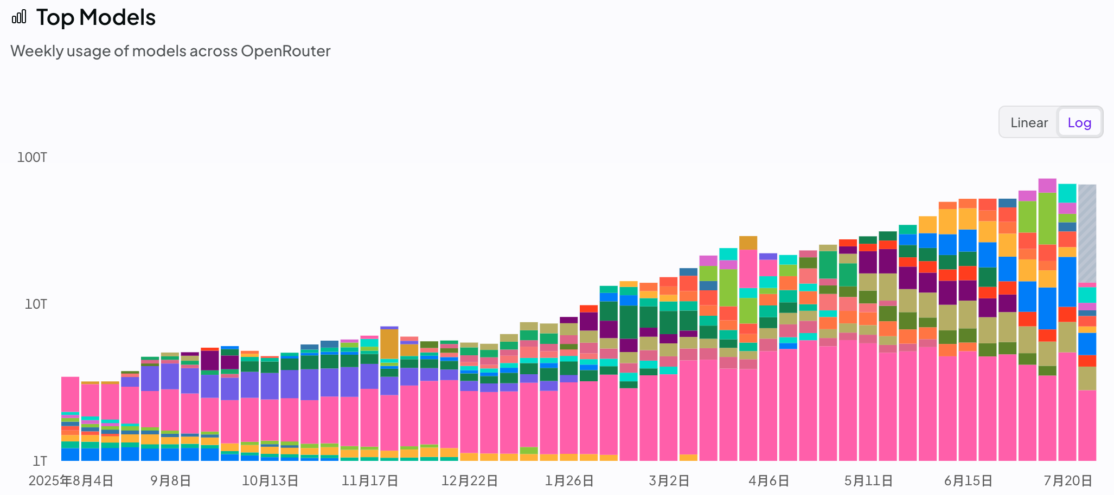
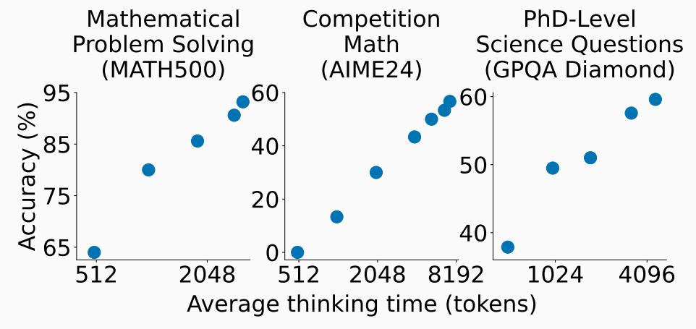

Token Consumption is Skyrocketing
StepFun ranks No.1 or No.2 in March, and still in top 10 today
Test-time scaling: longer inference time solves more complicated problems
https://arxiv.org/abs/2501.19393
Solving more complicated problems lead to more use case scenarios
More than 10x token consumption in a year (data from OpenRouter)
Notes:
In the last few months, token consumption has been skyrocketing.
Why? Because AI can solve more and more tasks and do them better and better. One of the reasons is test-time scaling.
Basically, the longer the AI can work continuously on its own, the more problems it can solve. So there is a compound effect – more token per task, and more tasks
I took a screenshot from OpenRouter, a popular model routing platform. The y-axis is log scale. We see that token consumption grows..

Slide 5
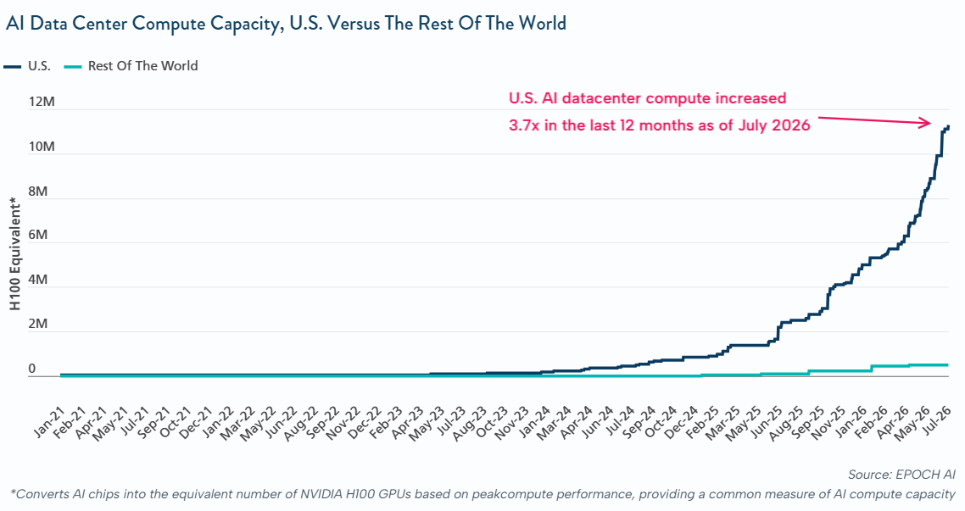
AI Compute Capacity is on a Slower Rocket
Chinese AI compute capacity grew 2x ~ 3x in a year
Based on data from Chinese government (Mar. 2026)
We must optimize LLM inference infrastructure to squeeze out more tokens per GPU!
Notes:
We all know tokens are generated by model inference, using GPUs, or more generally AI compute capacity.
We see a challenging future because the AI compute grows much slower than the need for tokens. Only 3.7x in U.S. compared with 10x tokens
This figure is from a US media, where they often don’t count China as the rest of the world.. So I plot the number form Chinese government, and the trend is similar.
So there is an urgent demand to squeeze..

Slide 6
Outline
Background
DistServe [OSDI’24]: prefill-decode disaggregation
Attention-FFN disaggregation
InfiniHBD [SIGCOMM’25]: scalable high-bandwidth domain
to facilitate disaggregation
Notes:
To optimize LLM inference, we at StepFun first proposed prefill-decode disaggregation with collaborators from academia.

Slide 7

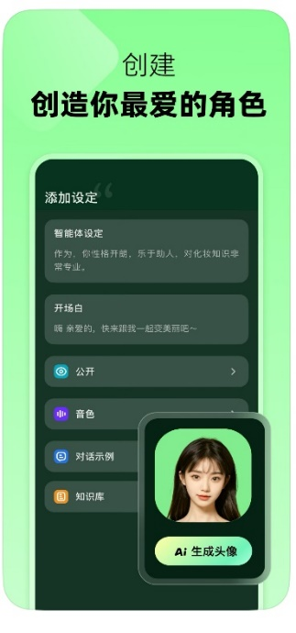
Our Story Begins from 2023..
MPY (discontinued)
AI roleplaying app
StepFun built an AI roleplaying app as the first trial
Product managers requested “reply in 1 second” and “faster than human can read”
Challenge 1: creators often write a very long prompt for a character, which the model needs time to process
Challenge 2: processing a new conversation can interrupt an old conversation on the same GPU
Notes:
Let’s dial back to 2023. StepFun was just founded.

Slide 8

Prefill for the First Token, Decode for the Rest
To
be
,
or
not
to
be
,
that
is
a
question
.
Key/Value Caches
Prefill Phase
Decoding Phase
Prefill speed determines time-to-first-token (TTFT), while decode speed is the output speed
Prefill (input) is more compute-bound，decode (output) is more memory bandwidth-bound
A “natural” idea is to isolate prefill and decode resources for respective SLO
Notes:
Here is very basic knowledge about LLM inference, just in case you don’t know.
There are two phases, prefill and decode.

Slide 9
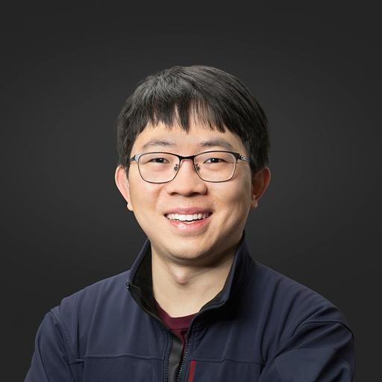
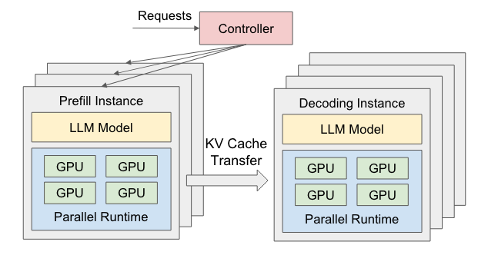
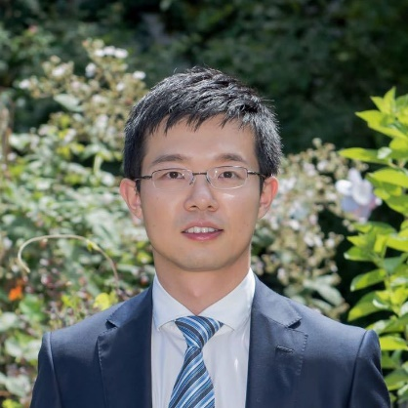
One Pager for Prefill-Decode Disaggregation
Hao Zhang (UCSD)
DistServe: Disaggregating Prefill and Decoding for Goodput-optimized Large Language Model Serving [OSDI’24]
Xin Jin (PKU)
Notes:
Following the natural idea, we propose DistServer with collaborators from UCSD and Peking University. The idea was so simple I can finish it in a slide…
Sometimes a simple idea like that can have a big impact.

Slide 10
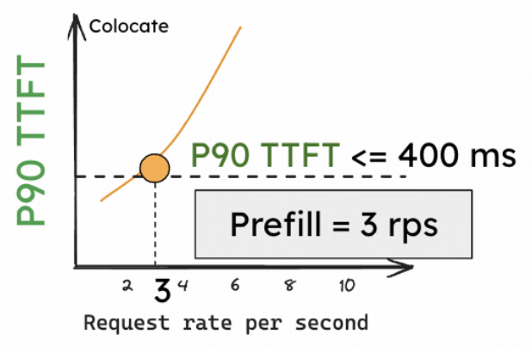
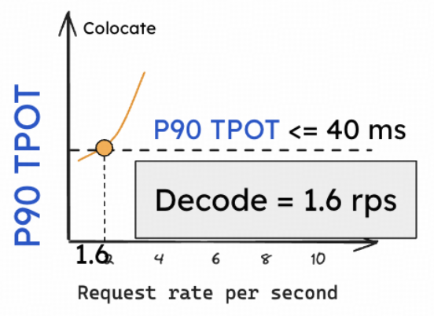
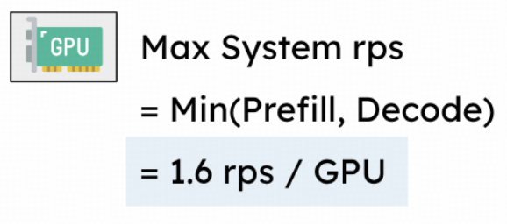
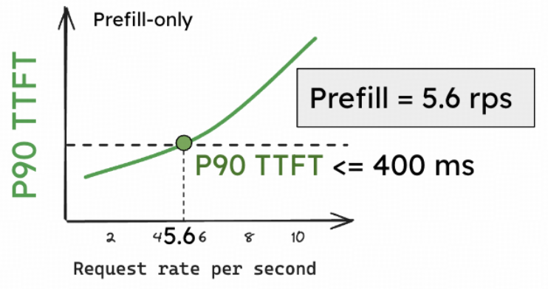
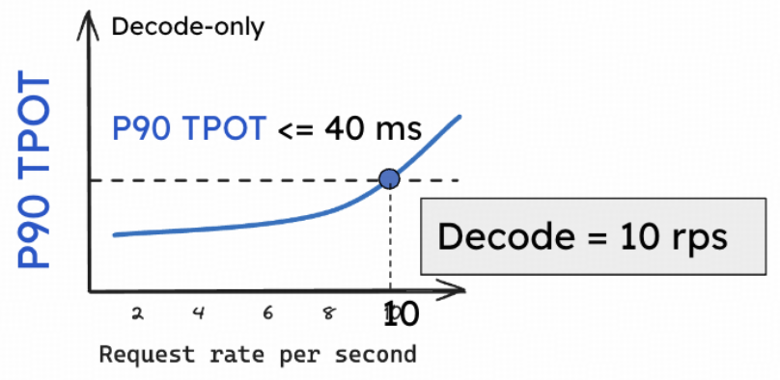

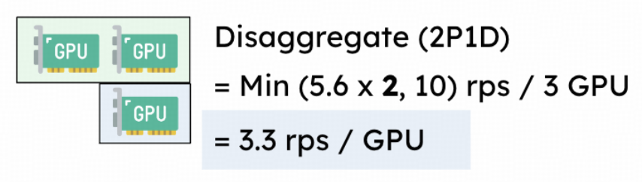



Evaluation: Double Per-GPU Throughput under SLO
Colocation
Disaggregation (2P1D)
Notes:
I also only need a slide for showing evaluation. Basically we take one GPU, running the old system, no disaggregation.
We mirror the online traffic and generate requests towards this instance. The GPU instance sometimes it needs to prefill, sometimes it needs to decode.
We sweep different request rates on x-axis, and observe how latency grows on y-axis
Then we apply prefill decode disaggregation…

Slide 11
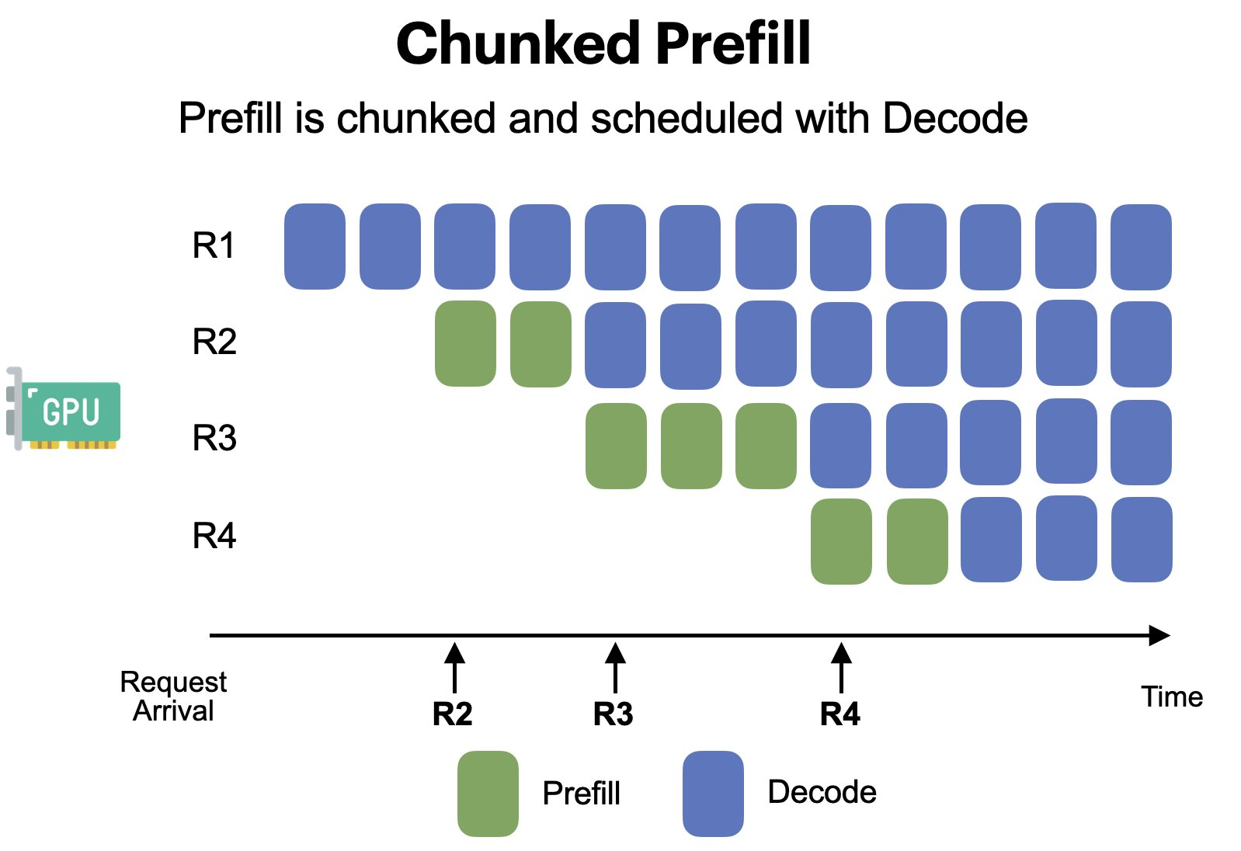
Behind-the-Scene Story: Challenges Raised by OSDI Reviewers
Chunked prefill splits a big prefill request into multiple chunks, and batches prefill chunks with other requests’ decode
Alleviate the SLO problem; is easier to implement; no communication needed; earlier to be merged into vLLM
Invoked debates; delayed the adoption of PD disaggregation
In the end, PD disaggregation stands and gets widely-adopted
SARATHI: Efficient LLM Inference by Piggybacking Decodes with Chunked Prefills
Notes:
All look cool, right? But the fact is that we did not get a very high score from OSDI reviews.

Slide 12
Additional Gain from PD Disaggregation + Heterogeneous GPUs
Model A prefill p_{A} : FLOPs
Model A decode d_{A} : bandwidth
App X average input length: i_{X}
App X average output length: o_{X}
50:50
Relative value for money | Compute FLOPs | Memory bandwidth
H100 | ~2 | ~0.25
H20 | 1 | 1
Optimal setup is better than 100% H100 or 100% H20
GPU’s value depends on different resources
Model B prefill p_{B} : FLOPs
Model B decode d_{B} : bandwidth
App Y average input length: i_{Y}
App Y average output length: o_{Y}
90:10
Notes:
Beyond the original motivation, it’s pretty straightforward to think about using heterogeneous GPUs for inference

Slide 13


Tussle between Inference Framework and Inference Cluster
Models and apps change by month
Mismatch
Hardware and clusters change by year
Pressure to lower the cost immediately
Lowest cost requires tailor-made heterogeneous cluster
By the time I finish the tailor-made heterogeneous cluster, will models and app change? How long will it last?
Middle ground: a mix-use cluster with a general, scalable/evolvable network
Notes:
Fundamentally, there is a mismatch between models, apps and hardware or clusters, regarding how frequently they change..

Slide 14
Outline
Background
DistServe [OSDI’24]: prefill-decode disaggregation
Attention-FFN disaggregation
InfiniHBD [SIGCOMM’25]: scalable high-bandwidth domain
to facilitate disaggregation
Notes:
Now prefill-decode disaggregation is well adopted, especially on homogeneous GPUs.
Then we move on to the next level of disaggregation, which is less mature now, but is gaining momentum.

Slide 15
Zoom in Decoding: the More Challenging Part
To
be
,
or
not
to
be
,
that
is
a
question
.
Key/Value Caches
Prefill Phase
Decoding Phase
Significantly lower MFU (FLOPs utilization than prefill)
Notes:
Let’s get back to the basic inference process.
Among the two phases, the decoding phase has more room for optimization

Slide 16
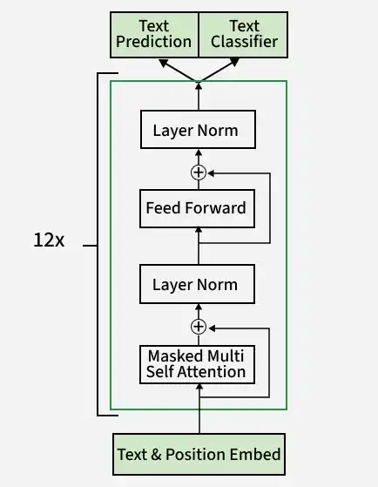
The Basis of Decoding
Every iteration of decoding, GPU has to access all parameters (or activated parameters in a MoE model) once
To decode one token, required FLOPs is so small that most of time is spent on memory access
Batching is very important for efficiency – one parameter access, multiple token generation
However, Attention and Feed Forward Network (FFN) behaves very differently with batching
Notes:
I will start with the basis of decoding, just in case some of you don’t know much about it.
For every iteration of decoding…

Slide 17
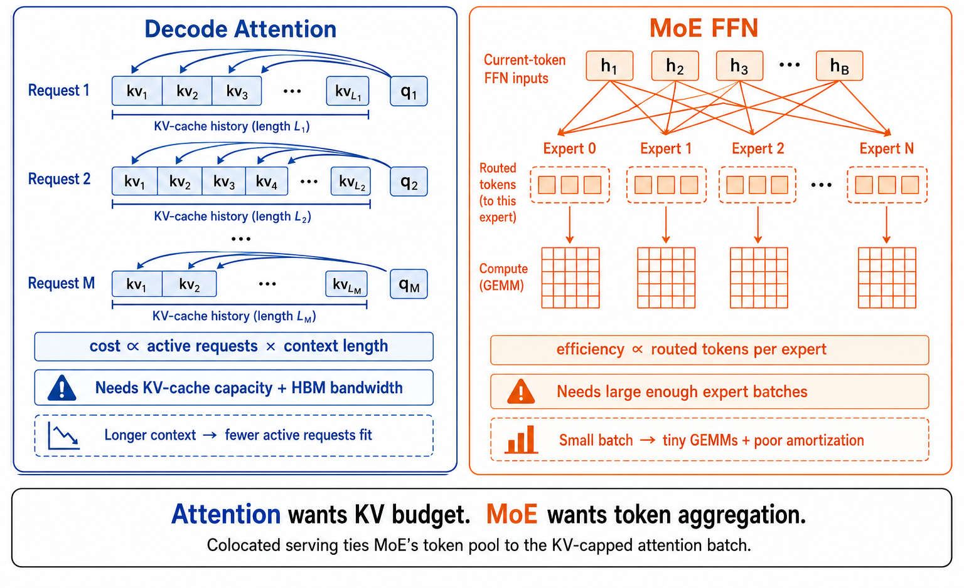
Difference between Attention and FFN during Decoding
Attention access KV cache (representation of past tokens)
Batching proportionally increases KV cache access
Batching requires more KV capacity without benefits
FFN access model parameters (90%+ for MoE model)
Batching amortizes memory access, which is great
Figure from https://haoailab.com/blogs/fastafd/
Notes:
Let’s start from attention. For every layer of attention computation, we have to access all the kv cache of this sequence.

Slide 18
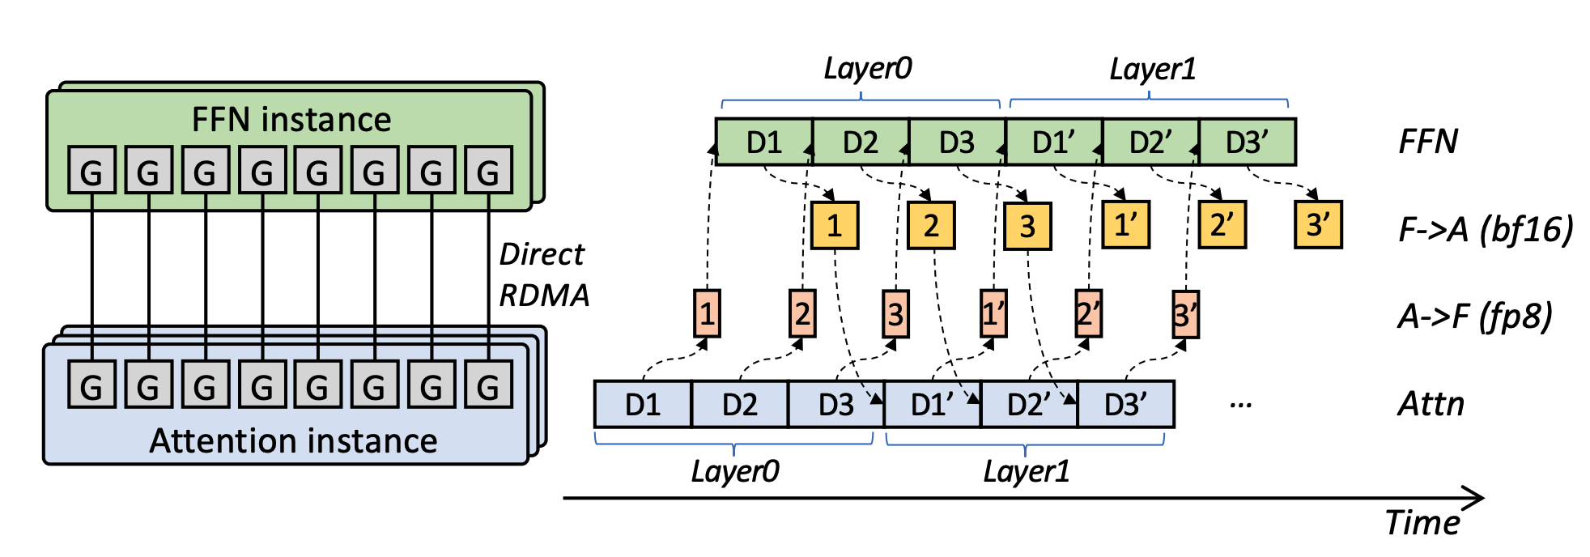
Attention-FFN Disaggregation (AFD)
Step-3 is Large yet Affordable: Model-system Co-design for Cost-effective Decoding
https://arxiv.org/pdf/2507.19427
https://github.com/stepfun-ai/StepMesh
Notes:
Last year, when we release our foundation model step-3, we also proposed afd….

Slide 19
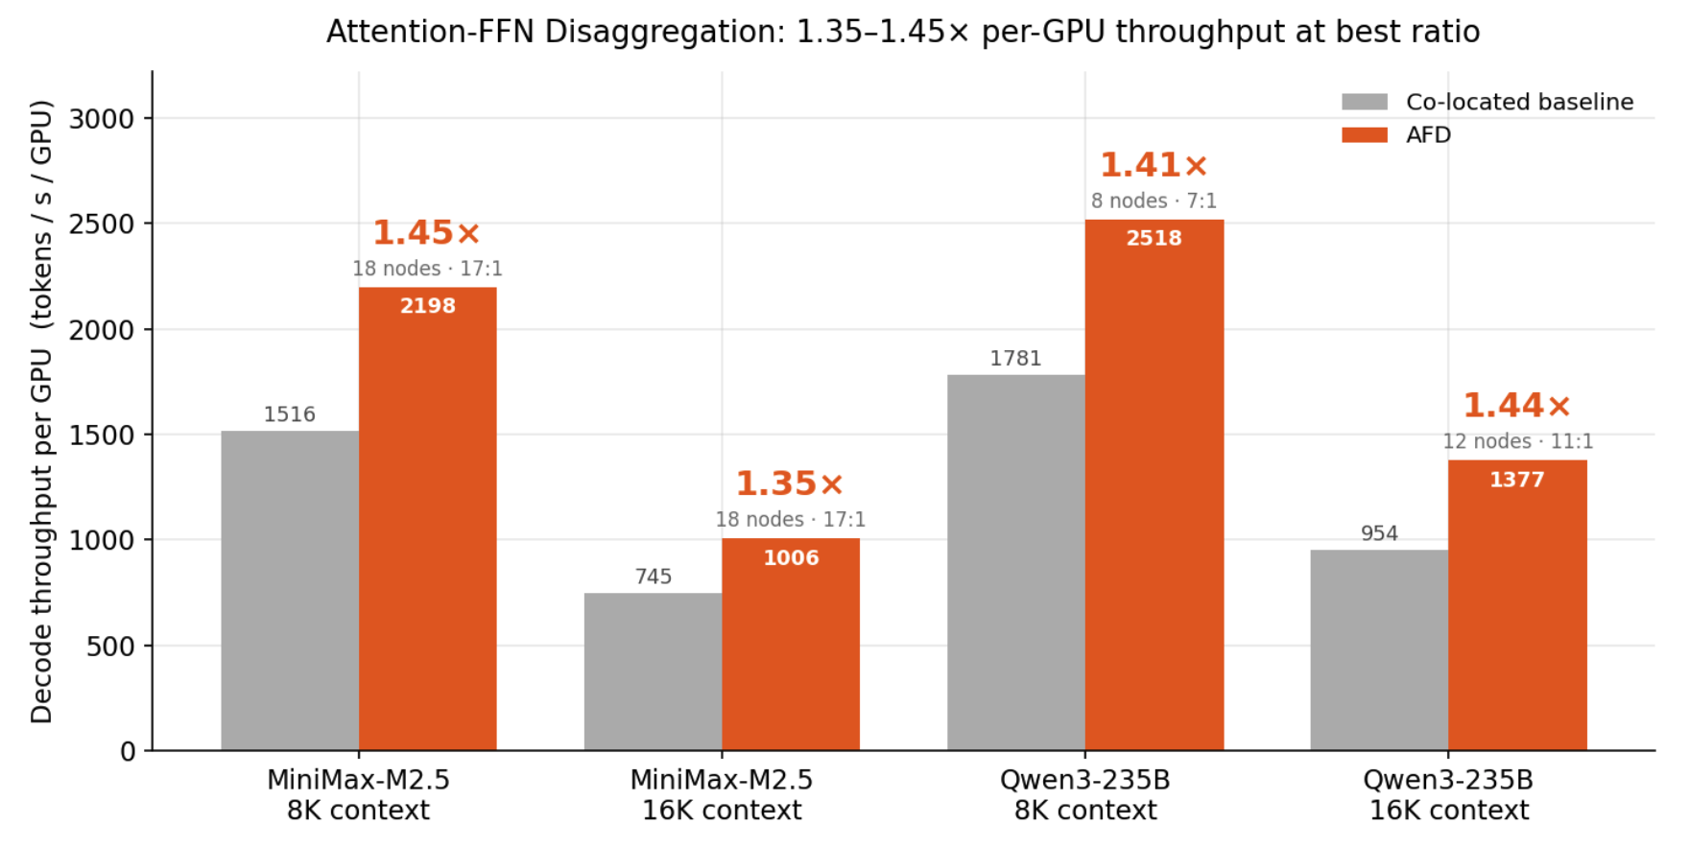
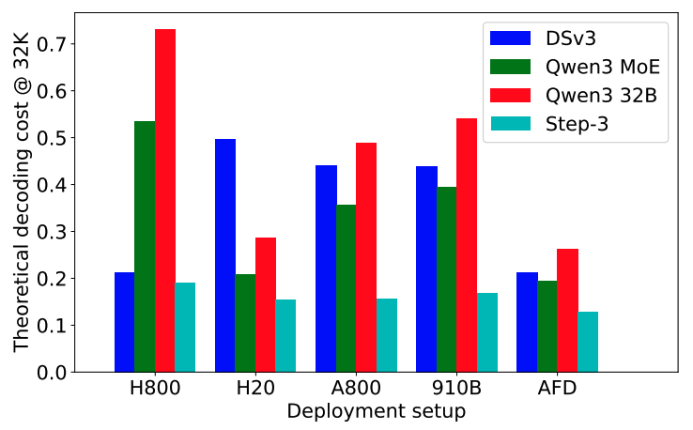
Performance Gains, Homogeneous and Heterogeneous AFD
Homogeneous GPU benefits from different batching strategies for attention and FFN
Figure from https://haoailab.com/blogs/fastafd/
Heterogeneous GPU has larger gains, theoretically
Figure from our Step-3 paper
Notes:
Here are the evaluation results

Slide 20
The Challenges of Heterogeneous AFD -- déjà vu？
Models and apps change by month
Mismatch
Hardware and clusters change by year
Even higher requirement: 100x bandwidth
(per-request communication → per-model-layer communication)
Pressure to lower the cost immediately
Lowest cost requires tailor-made heterogeneous cluster
By the time I finish the tailor-made heterogeneous cluster, will models and apps change? How long will it last?
Middle ground: a mix-use cluster with a general, scalable/evolvable network
Notes:
To make heterogeneous AFD practical, again we face challenges. If you notice, this is actually the same page as the previous section

Slide 21


Scalable
Ideally, scale to data-center wide
Scale -> flexibility for future models and apps
Calling for next generation network to connect GPUs
High-bandwidth
TB/s per GPU bandwidth
Sub-microsecond latency
Deployment-friendly
General for different GPU/AI chips
Affordable
Fault-tolerant
Notes:
Both the prefill-decode disaggregation and attention-ffn disaggregation call for next generation networks

Slide 22
Outline
Background
DistServe [OSDI’24]: prefill-decode disaggregation
Attention-FFN disaggregation
InfiniHBD [SIGCOMM’25]: scalable high-bandwidth domain
to facilitate disaggregation
Notes:
At last, I will share one of our early attempts to build such a network

Slide 23
Existing High-Bandwidth Domain (HBD) Architectures
Switch-centric
e.g. NVIDIA NVL-72
GPU-centric
e.g. SiP-Ring, Tesla Dojo
Switch-GPU Hybrid
e.g. Google TPUv4
But all of them suffer from scalability, cost, fragmentation,
and fault resilience issues.
Notes:
We group HBD architectures into three categories based on how they connect GPUs. Switch-centric, GPU-centric, and switch–GPU hybrid.
But all of them suffer from scalability, cost, fragmentation, and fault resilience issues.

Slide 24
Switch-centric HBDs
Pros
Switch chips interconnect GPUs
e.g. NVIDIA GB200 NVL-36/72/576
High-performance any-to-any communication
...
Cons
High cost and low scalability
Resource fragmentation
EP16
EP16
Bandwidth degradation
Switch-level fault explosion radius
Unusable
Notes:
1. The first type is switch-centric HBDs. They connect all GPUs through switch chips to form a non-blocking network. A typical example is NVIDIA GB200 NVL series. On the left is NVL-36.
2. The strength of this design is high-performance any-to-any communication.
3. But it comes with clear drawbacks.
First, the heavy use of high-performance switches and links like NVSwitch and NVLink makes it very expensive and limits its scalability.
4. Second, limited scale leads to significant resource fragmentation.
5. For instance, in NVL-36 with TP-16, one node always remains unusable, even when it is healthy.
6. (2 act) Finally, the failure of any single switch degrades the bandwidth of all connected GPUs. We call this the switch-level fault explosion radius.

Slide 25
GPU-centric HBDs
Pros
Direct GPU-to-GPU connections
e.g., SiP-Ring ^{[SIGCOMM’21]},Tesla Dojo
Low cost and high scalability
Break the entire ring topology to line
Cons
Low-performance any-to-any communication
HBD-level fault explosion radius
Bandwidth degradation
Notes:
1. The second type is GPU-centric HBDs. These use direct GPU-to-GPU connections to form torus or mesh-like topologies. Examples include Tesla Dojo and SiP-Ring.
2. This design reduces the use of switches and links, which lowers cost and improves scalability.
3. However, the drawbacks are significant.
First, the collective communication they can support efficiently is limited, and any-to-any performance is low.
4. Second, they suffer from HBD-level fault explosion.
Take SiP-Ring as an example.
5. If a single node fails, its links go down.
6. This degrades the bandwidth of its neighbors
7. and breaks the entire topology from ring to line, degrading the whole HBD.

Slide 26

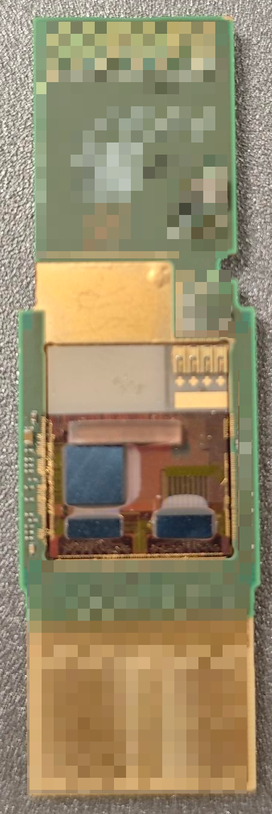
Our Solution: InifiniteHBD
Transceiver-centric HBD
Unifies connectivity and switching at the transceiver level using OCS
OCS Transceiver
Reconfigurable K-Hop Ring
HBD-DCN Orchestration
Aggregation
Other nodes
ToR
ToR
ToR
ToR
DCN
Orch.
InfiniteHBD
Notes:
1. Our key idea is to build a transceiver-centric HBD. We unify connectivity and switching at the transceiver level using optical circuit switching, or OCS for short.
The design has three parts: the OCS transceiver hardware, the reconfigurable K-hop ring topology, and an HBD-DCN orchestration algorithm.
2. Because of time, I will only focus on the first two. You can find the orchestration details in the paper.
Together, these designs bring us very close to an ideal HBD.

Slide 27
Design #1: OCS Transceiver (OCSTrx)
Tech.
External Path #1
External Path #2
Integrate OCS into standard
QSFP-DD 800Gbps transceiver
60-80 μs
SiPh-based MZI switch matrix
simple, cheap, energy-efficient
Loopback Path
Func.
Connects two GPUs and provide three communication paths
Time-division multiplexed
60-80 μs reconfiguration latency
27
Notes:
1. The first design is the OCS transceiver, or OCSTrx for short.
2. We integrate OCS into standard 800Gbps QSFP-DD transceiver.
3. The OCS is based on silicon photonics MZI switch matrix, which is simple, cheap, and energy-efficient.
4. For function,
5. each OCSTrx connects the two GPUs inside a node
6. and provides three communication paths.
Two external links connect to other nodes, and one loopback link connects the two GPUs locally.
7. These three paths are time-division multiplexed, with only one active at a time. (+2 act)
8. Switching between them takes about sixty to eighty microseconds.
OCSTrx provides strong functionality and efficiency, giving us the opportunity to build the InfiniteHBD topology.

Slide 28
Design #2: Reconfigurable K-hop Ring
Def.
Other
nodes
Each node connects to all other nodes in the cluster within K hops via OCSTrx
1
7
2
6
Func.
Dynamic ring construction
arbitrary size, arbitrary location
3
5
4
Inter-node fault isolation
bypass the faulty node,
near node-level fault radius
X-GPU ring
Notes:
1. The second design is the reconfigurable K-hop ring topology.
2. In the topology, each node connects to all other nodes in the cluster within K hops via OCSTrx.
3. The first feature of this topology is dynamic ring construction. By activating different OCSTrx paths, we can build rings of arbitrary size and locations at GPU granularity, which enables flexible HBD.
But when node 2 fails,, we can simply bypass node 2. Activate the link from node 1 to its next-nearest neighbor, node 3.

Slide 29
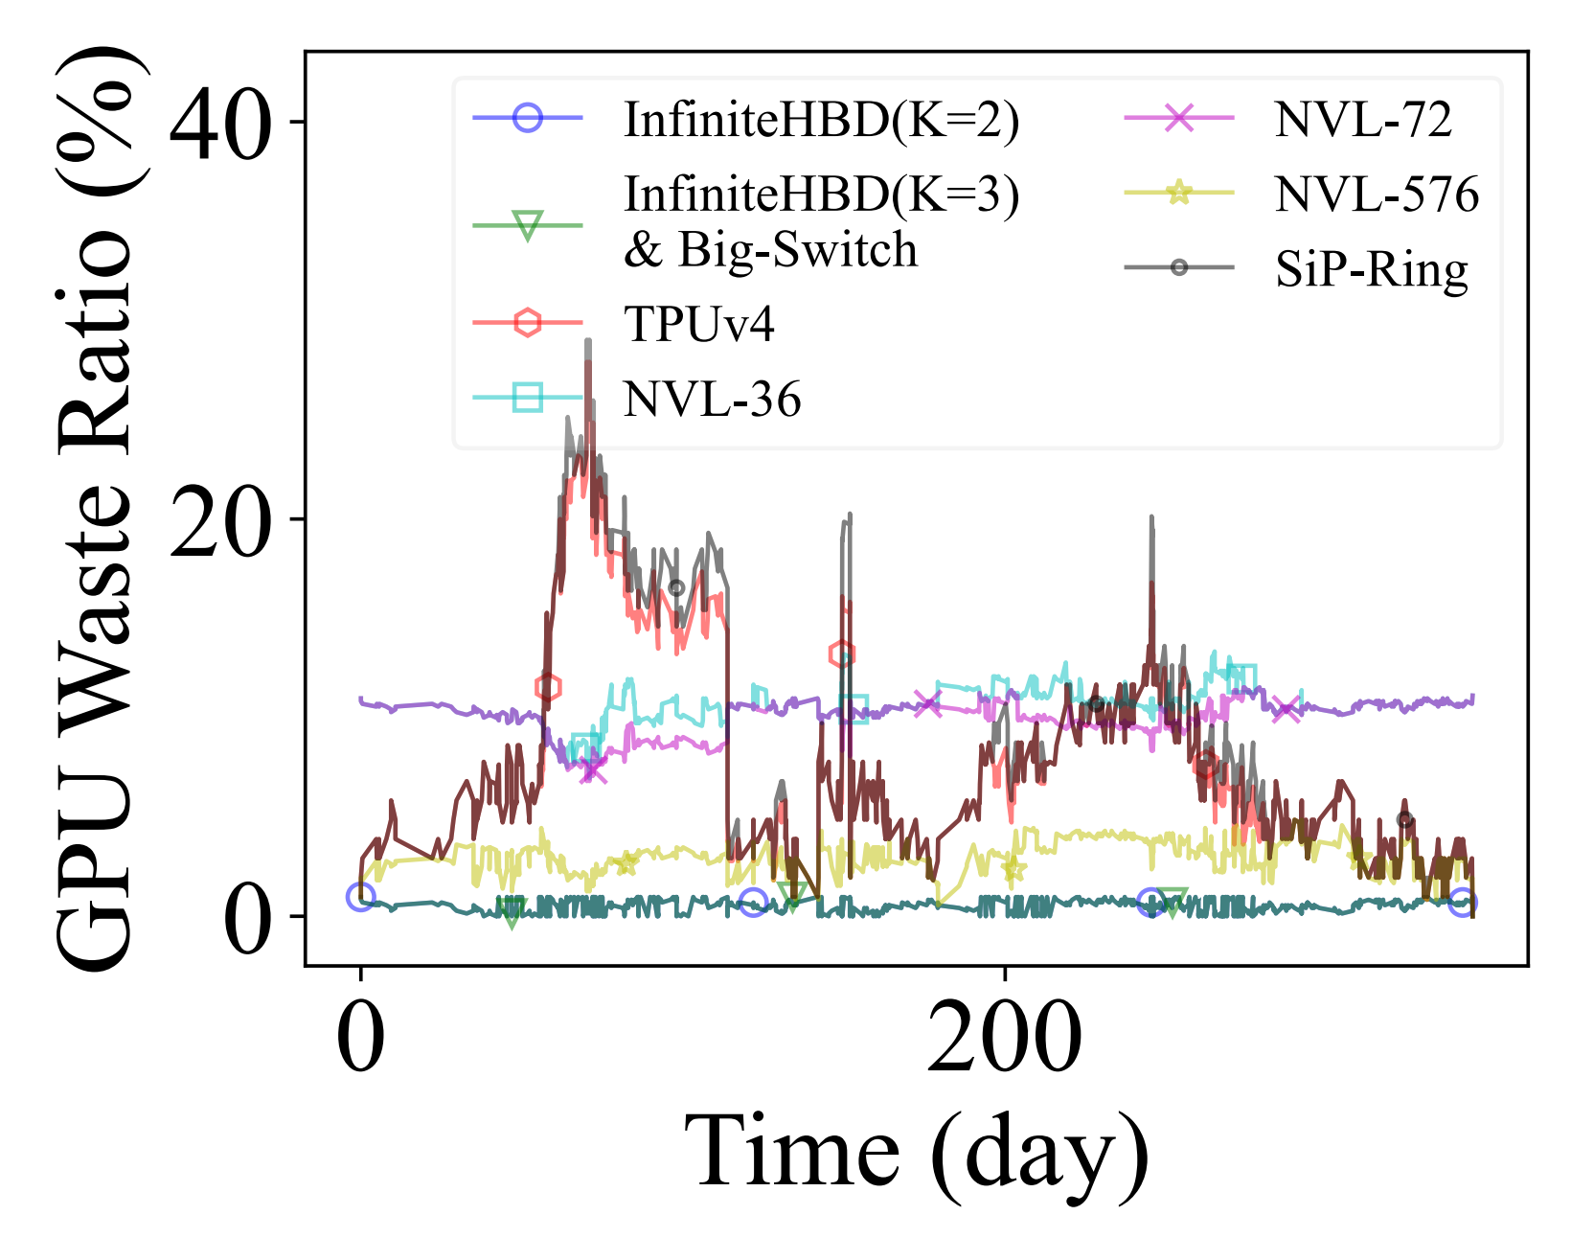
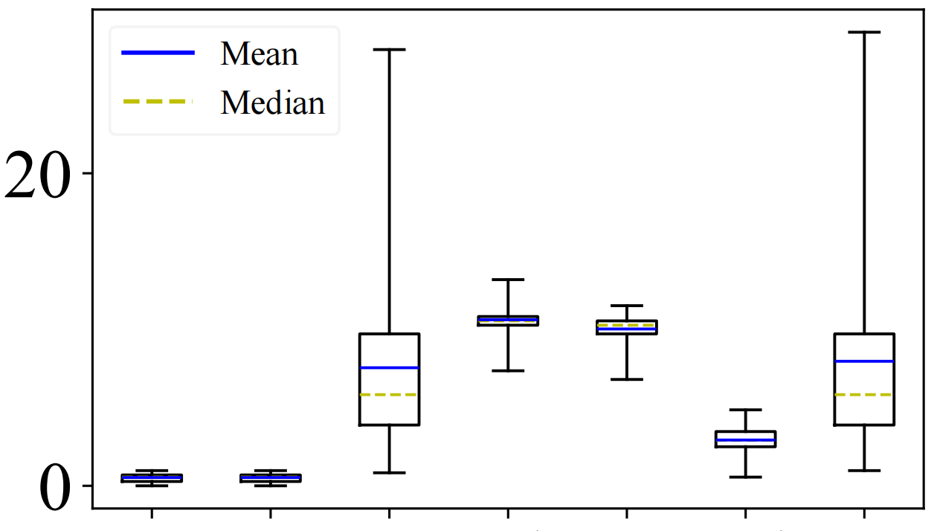
Evaluation: Fault Resilience Simulation
GPU Waste Ratio (%)
14x
20x
InfiniteHBD
Big-Switch
SiP-Ring
TPUv4
NVL-36
NVL-72
NVL-576
Simulation on fault trace
Near-ideal GPU wasted ratio
14x lower than TPUv4, 20x lower than NVL-72
Notes:
1. Next, the fault resilience simulation.
2. Using the trace, we measure the ratio of wasted GPUs over time under different HBDs.
3. InfiniteHBD comes very close to the ideal big switch.
4. Moreover, compared to TPUv4, it reduces GPU waste by 14 times. Compared to NVL-72, it reduces waste by 20 times. This shows strong fault resilience.

Slide 30
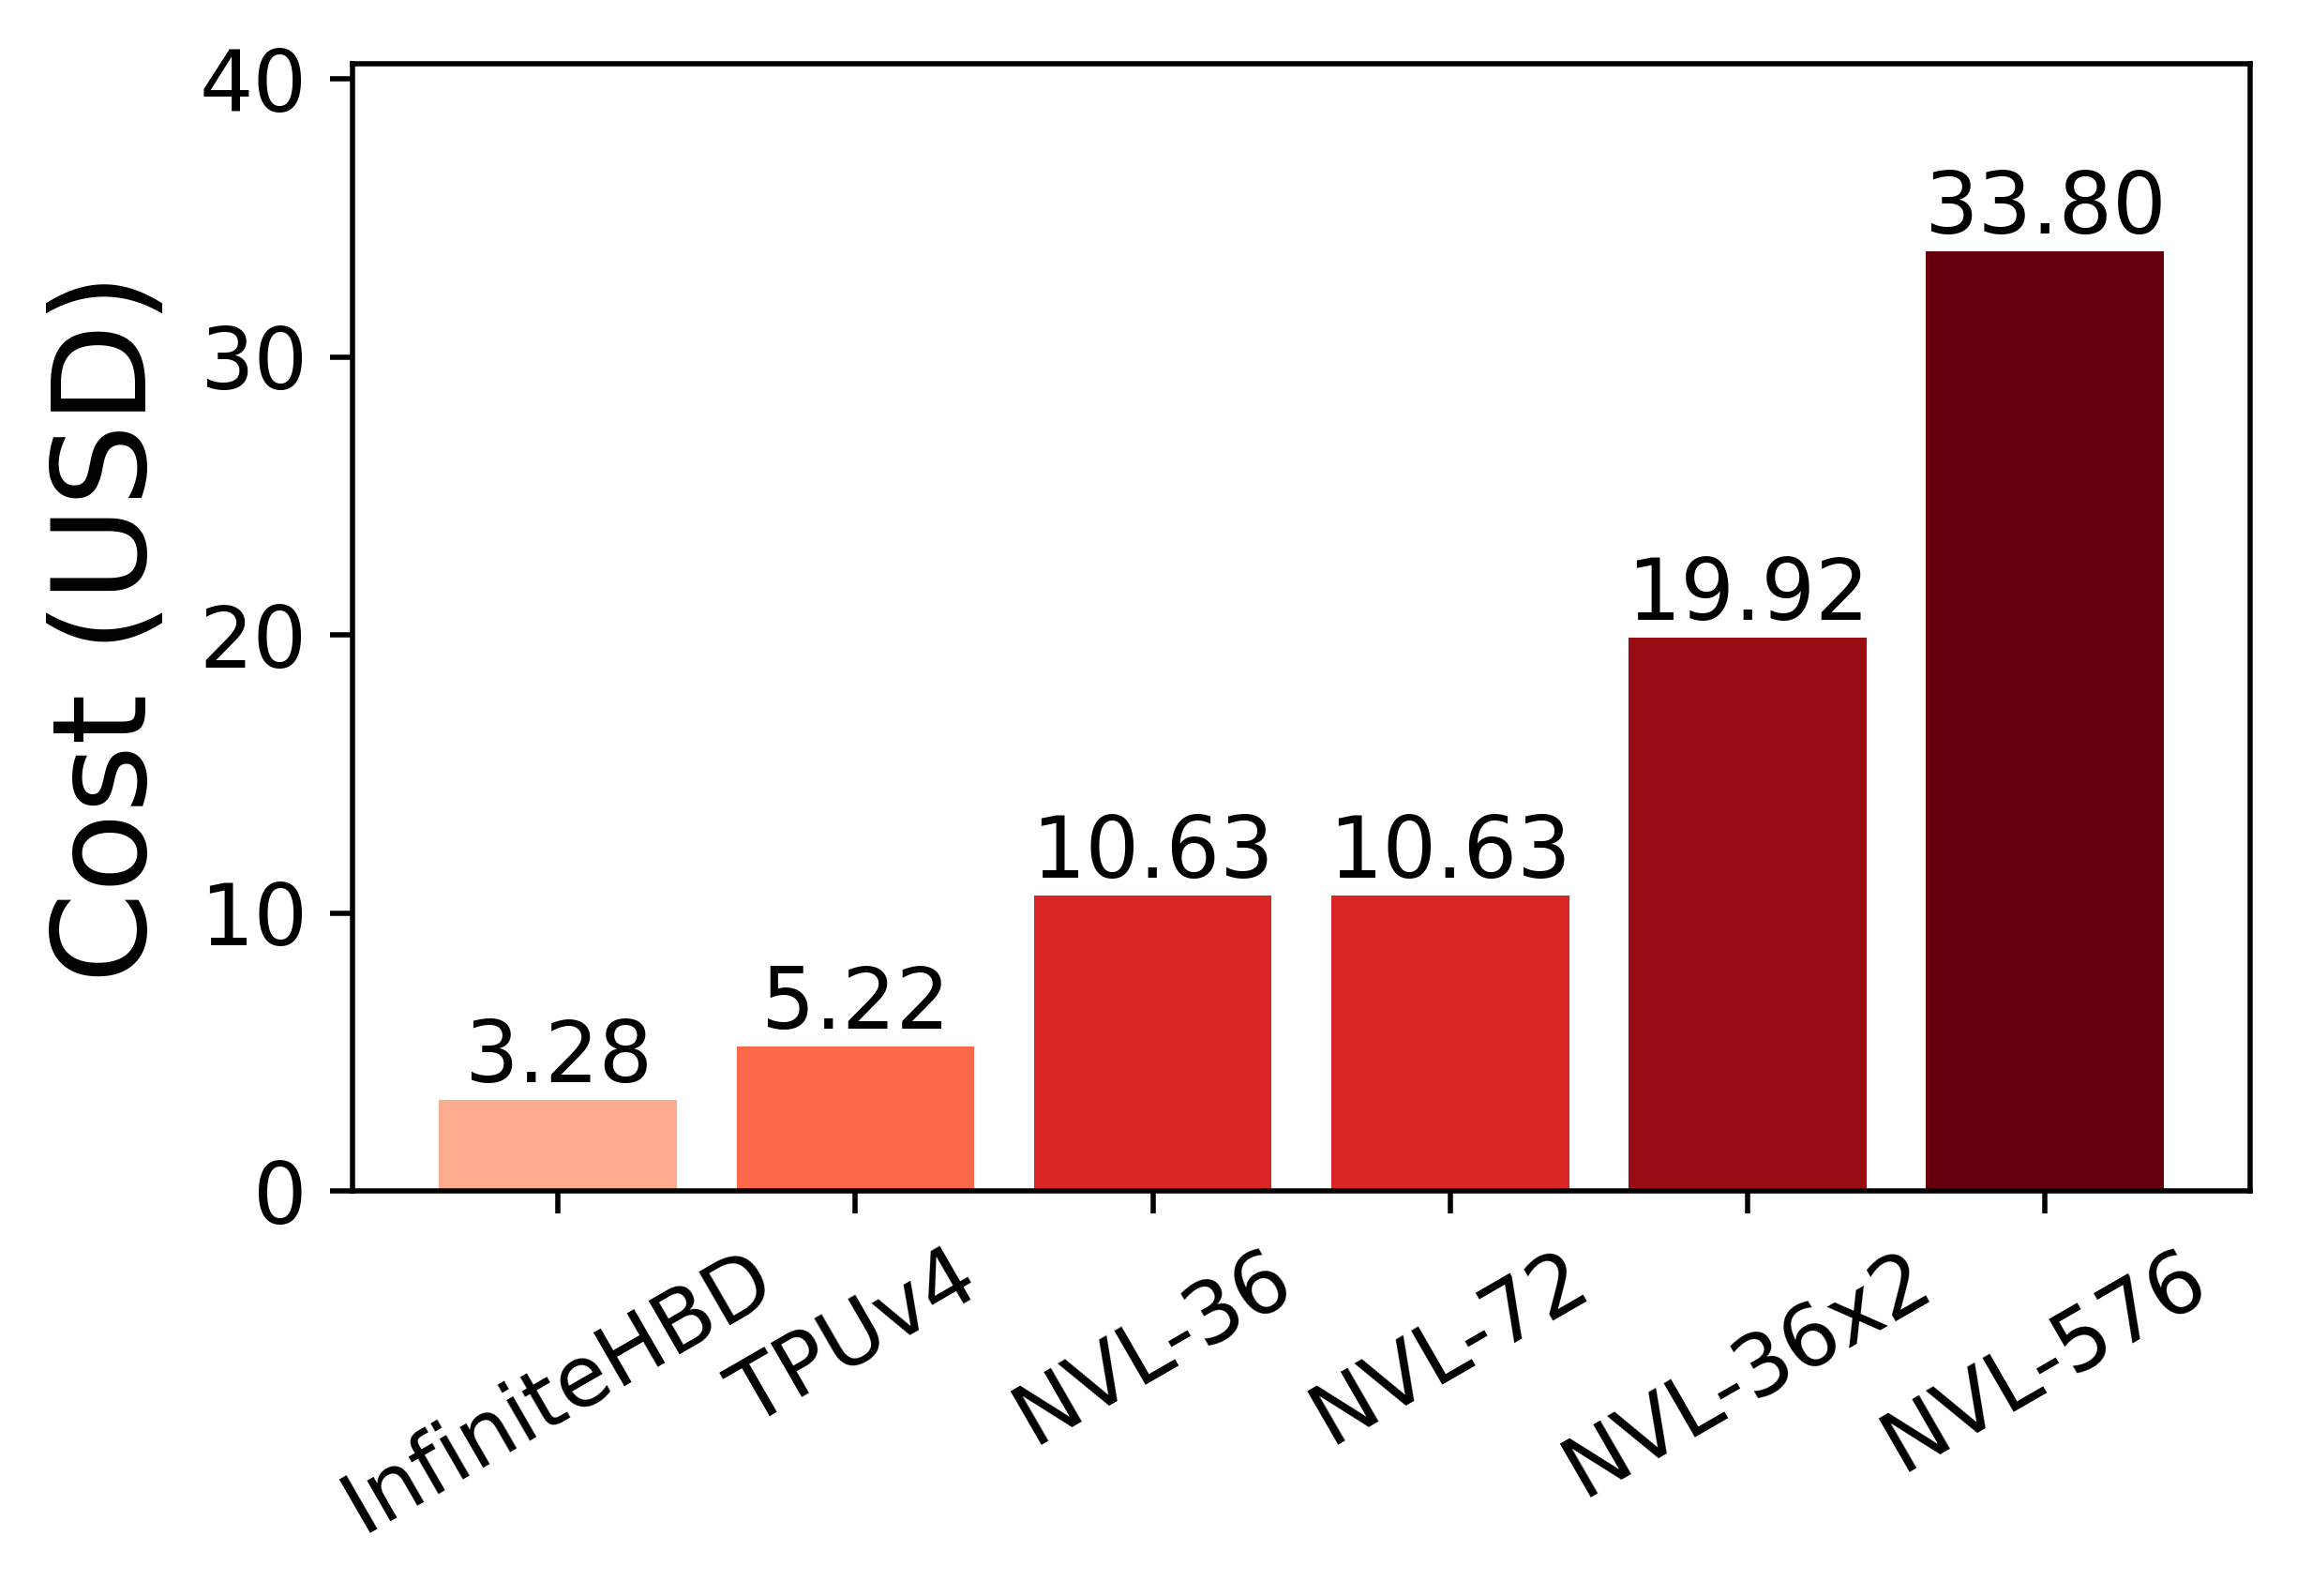
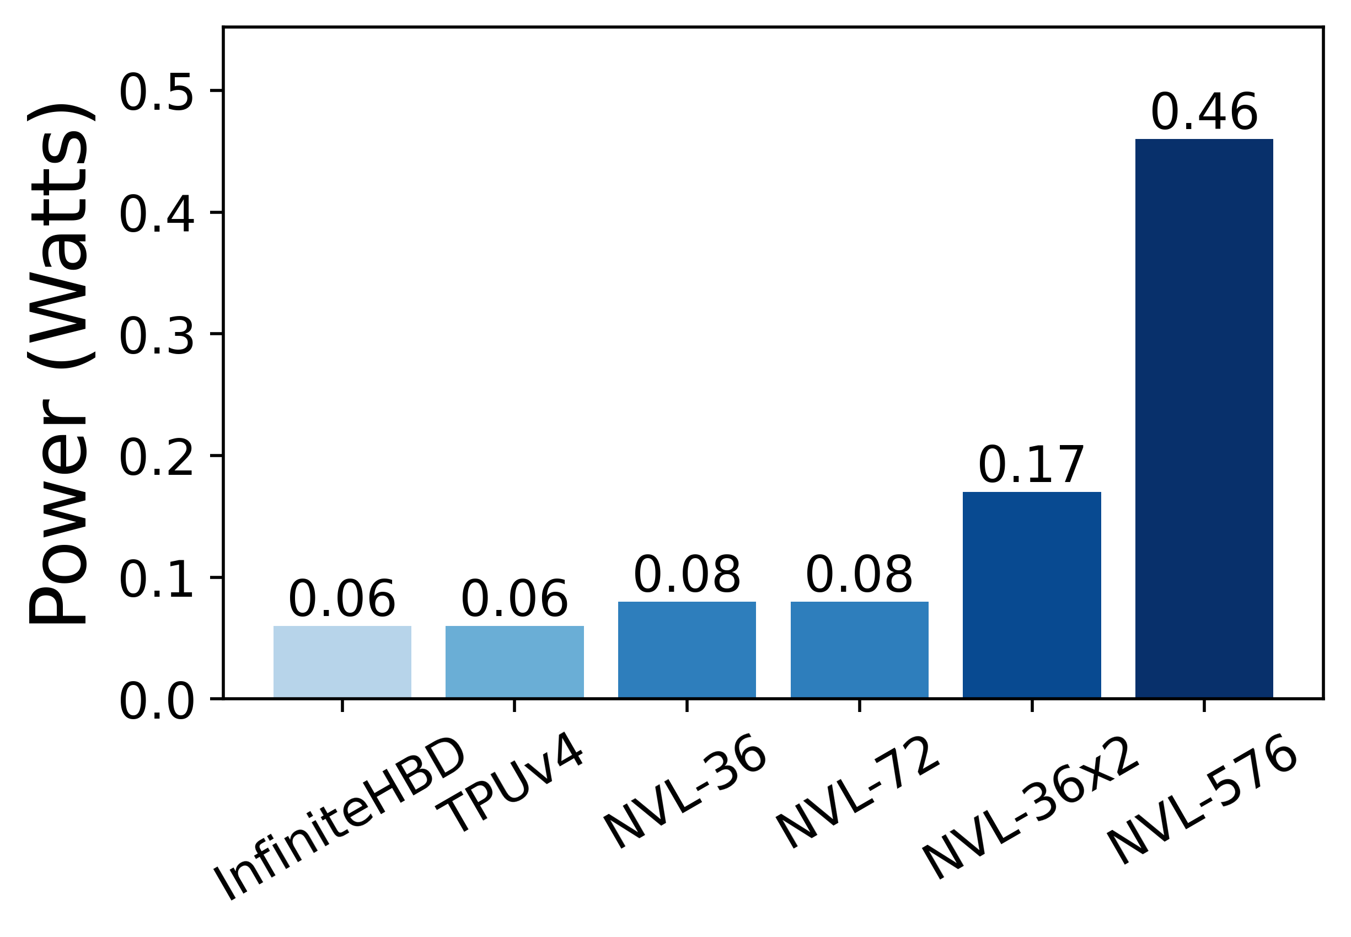
Evaluation: Cost and Power
10.1x
7.7x
6.1x
3.2x
3.2x
2.8x
1.5x
1.0x
1.3x
1.3x
Cost ^{per GPU per GBps}
InfiniteHBD: most cost-efficient
3.2x cheaper than NVL-72,
1.5x cheaper than TPUv4
Power ^{per GPU per GBps}
InfiniteHBD: most energy-efficient
1.3x lower than NVL-72,
same as TPUv4
Notes:
1. Finally, the estimates of cost and power.
We normalize cost and power by bandwidth per GPU, so they are directly comparable.
2. In terms of cost, InfiniteHBD is the most efficient. It is 3.2 times cheaper than NVL-72, and 1.5 times cheaper than TPUv4.
3. In terms of power, InfiniteHBD is also the most efficient. The power consumption of InfiniteHBD is 1.3 times lower than NVL-72.

Slide 31
Conclusion
It is important to optimize LLM inference
Disaggregation is a proved and promising method
To exploit the full potentials of PDD and AFD, we need scalable HBD
InfiniteHBD is an early attempt to make HBD scalable, fault-tolerant and low cost

Slide 32
Thank you
August 7th, 2026

